Slide 1
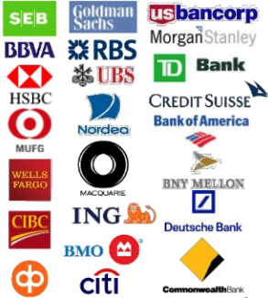
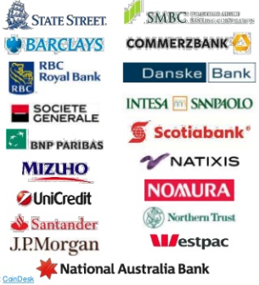
Alexis Schottenstein
“A Next Gen Blockchain”

Slide 2
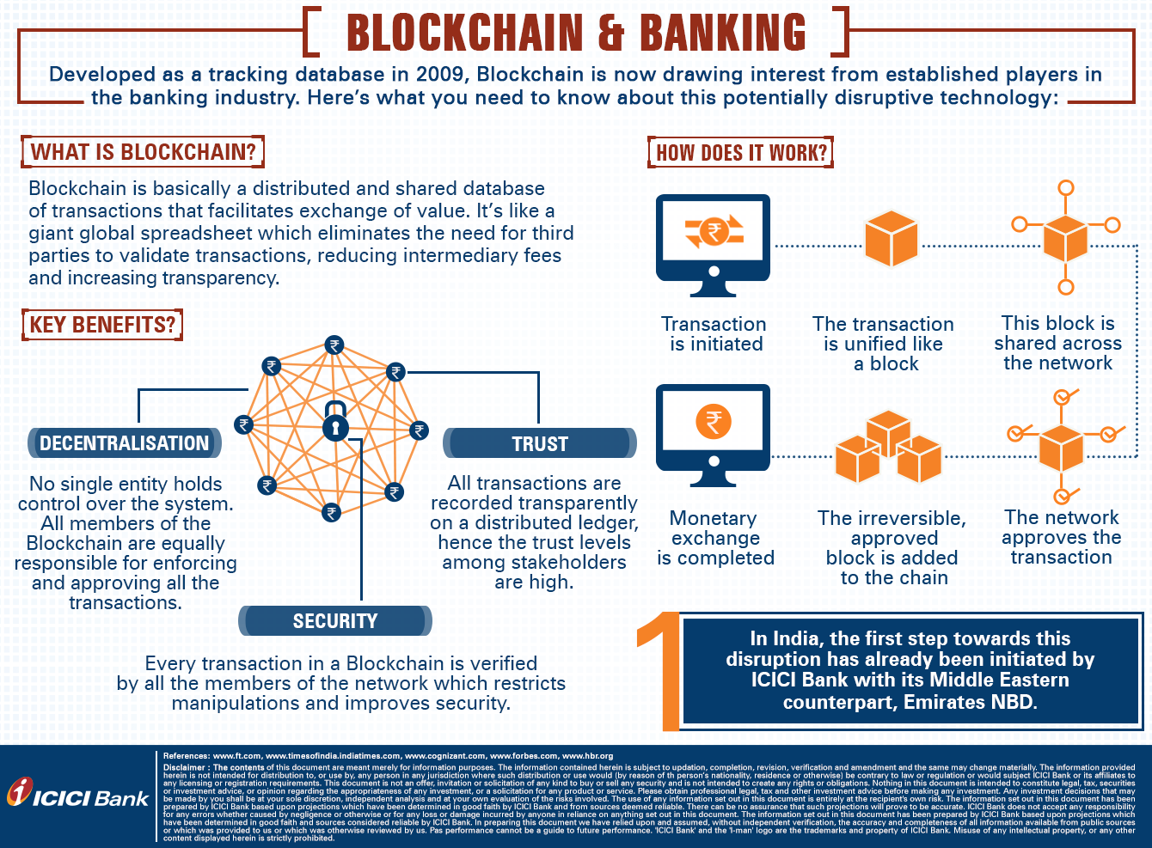

Slide 3
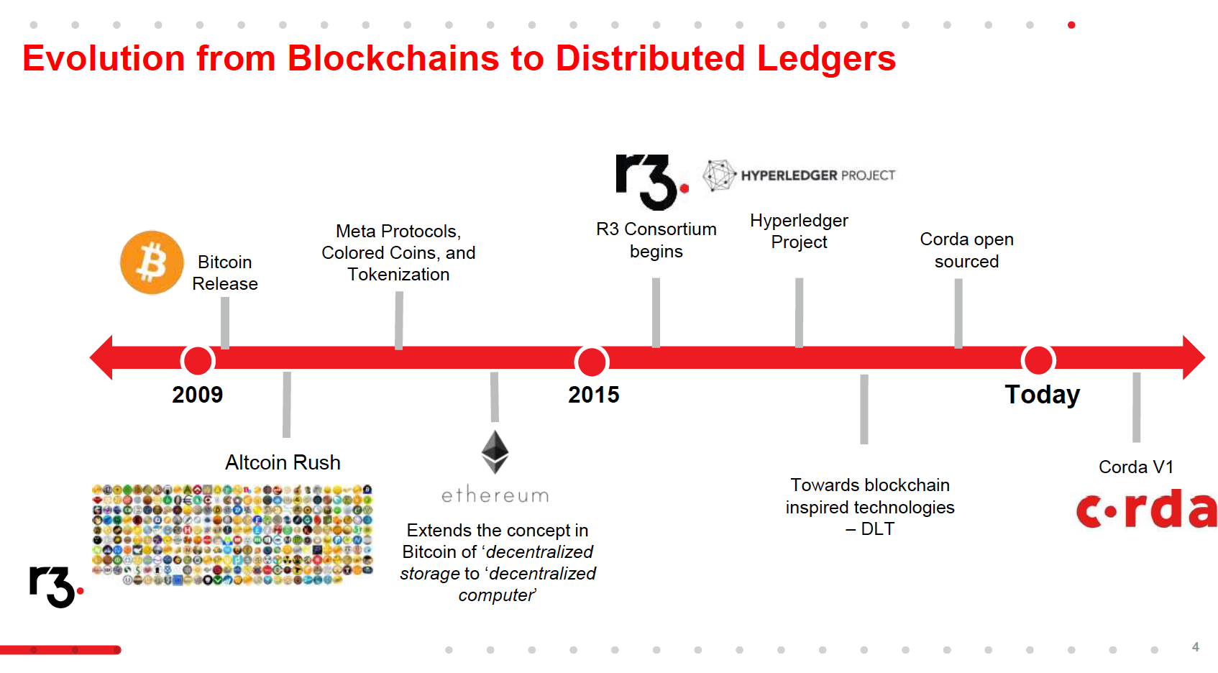
https://www.slideshare.net/CoinDesk/state-of-bitcoin-and-blockchain-2016-57577869/99-R3_CEVs_Consortium_42_Banks

Slide 6
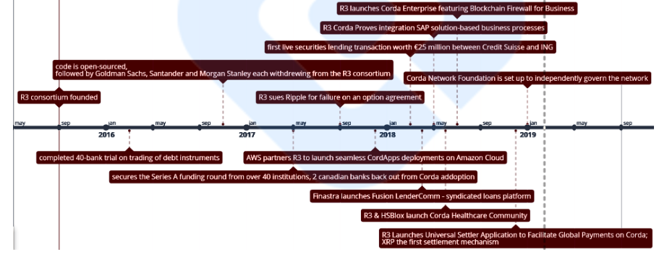
Corda Roadmap
https://medium.com/newcryptoblock/hyperledger-fabric-vs-r3-corda-7954035a4884

Slide 7
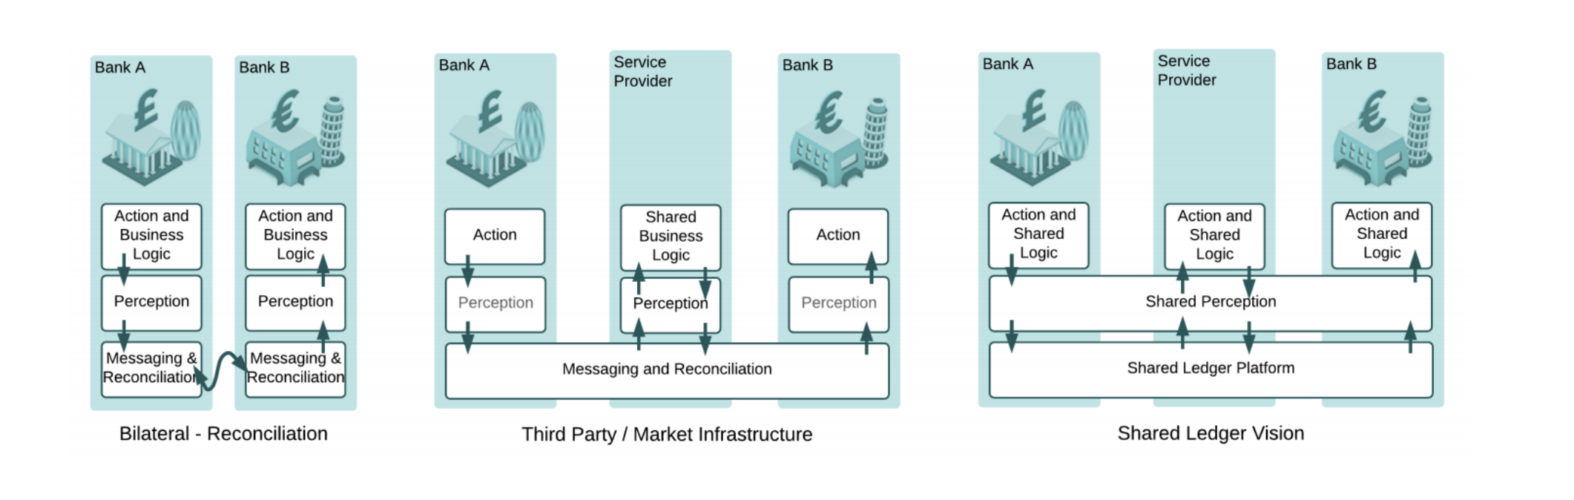
Corda Vision
https://www.corda.net/content/corda-platform-whitepaper.pdf
“…a future where legal agreements such as business contracts are recorded and automatically managed without error, where anybody can transact seamlessly for any contractual purpose without friction. We believe markets will move towards models where parties to contracts collaborate to maintain accurate, shared records rather than maintaining their own independent and inconsistent systems which require extensive reconciliation processes to ensure consistency. Duplicates, reconciliations, failed matches and breaks will be things of the past. Isolated pools of trapped assets will be no more.”

Slide 8
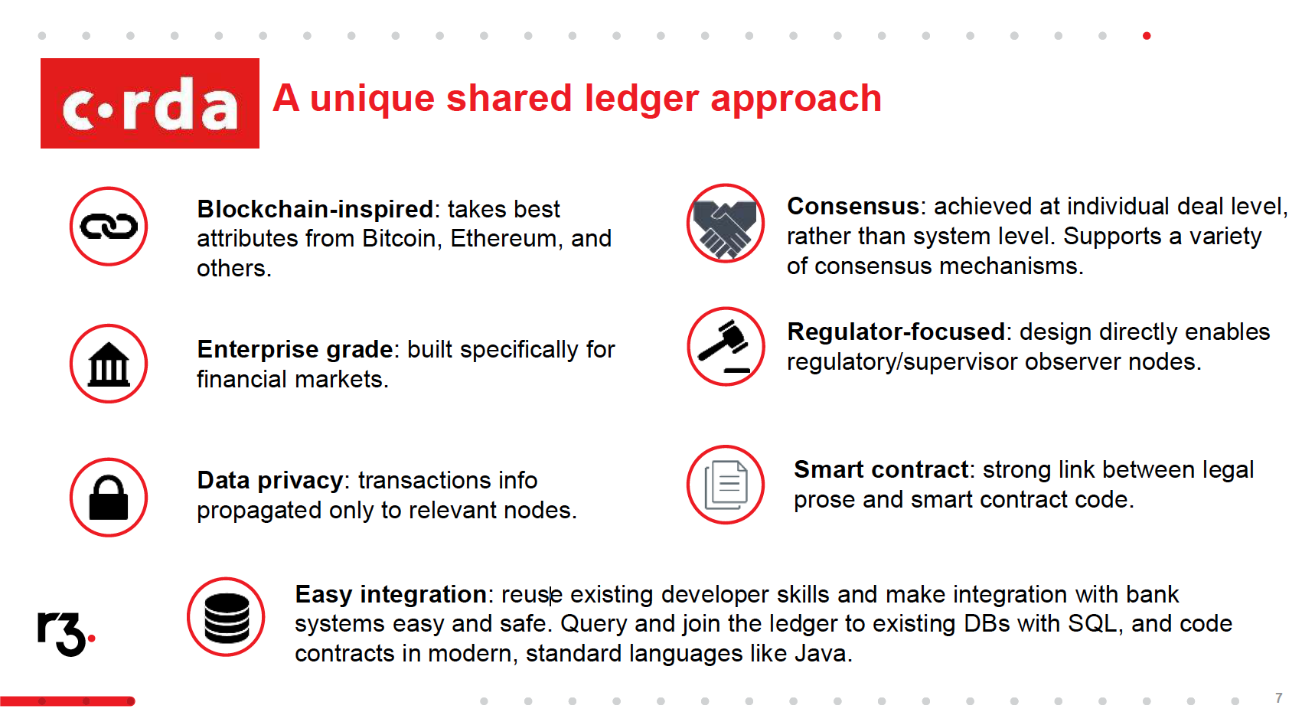
https://www.slideshare.net/CoinDesk/state-of-bitcoin-and-blockchain-2016-57577869/99-R3_CEVs_Consortium_42_Banks

Slide 9
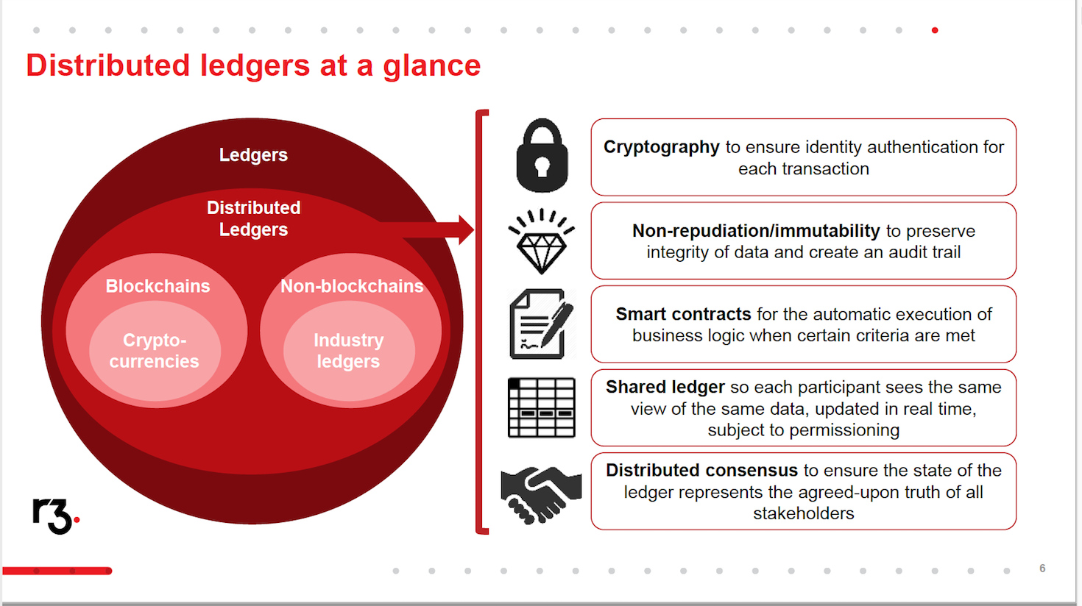
https://www.slideshare.net/CoinDesk/state-of-bitcoin-and-blockchain-2016-57577869/99-R3_CEVs_Consortium_42_Banks

Slide 10
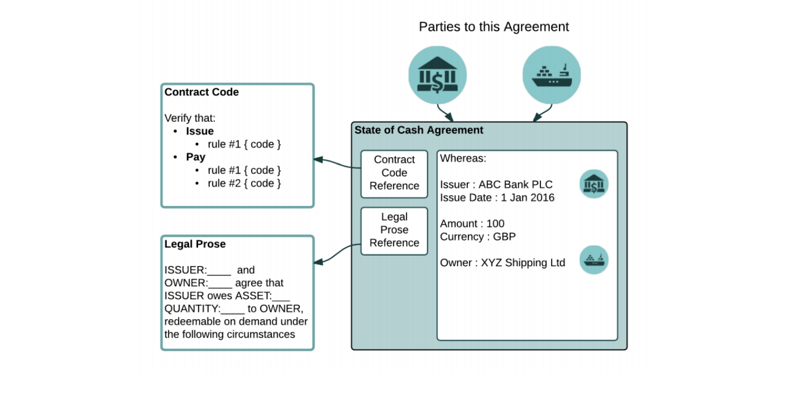
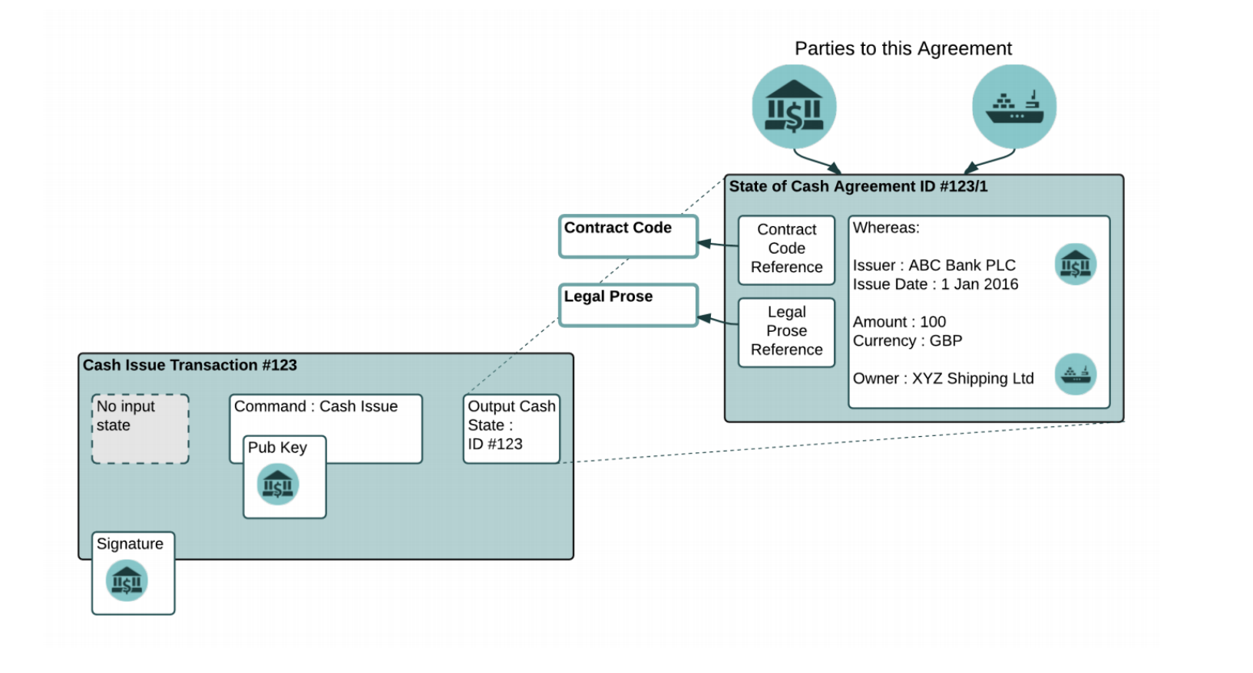
https://www.corda.net/content/corda-platform-whitepaper.pdf

Slide 11
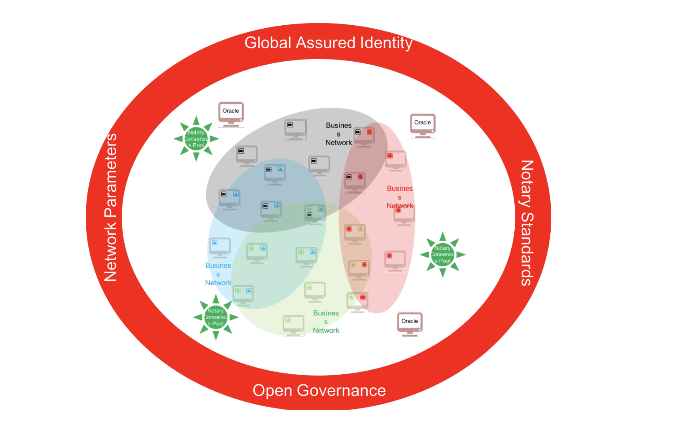
https://www.corda.net/content/corda-platform-whitepaper.pdf

Slide 13
R3 Management
Team:
David E. Rutter: Founder, Chief Executive Officer With over 30 years of experience leading some of Wall Street’s top institutions, David Rutter is a longtime creative thought leader in financial markets and innovation and has played a significant role in the adoption of electronic trading in the global over-the-counter derivatives industry. Rutter served for 10 years as the chief executive officer (CEO) of electronic brokerage at ICAP Plc, the world’s largest interdealer brokerage firm, where he led the Brokertec fixed income platform and the EBS foreign exchange platform. Prior to ICAP Plc, Rutter was co-owner and CEO (Americas) of Prebon Yamane.
James Carlyle: Chief Engineer James Carlyle is focused on defining a candidate architecture and building out a collaborative lab for experimentation by network members.
Mike Hearn: Lead Platform Engineer Mike Hearn is lead platform engineer at R3. He has over five years of experience with bitcoin, blockchain, and distributed ledger systems. He spent nearly eight years at Google, where he was a senior software engineer. Hearn was one of the world’s first developers of software for the bitcoin platform, including its smart contract capabilities. He developed the world’s most popular bitcoin wallet software.
Richard Gendal Brown: Chief Technology Officer Richard Brown is the chief technology officer at R3 and is one of the world’s leading authorities on distributed ledger systems and architectures. Previously, Brown was the executive architect for banking and financial markets industry innovation at IBM United Kingdom. His previous roles with the company, for whom he worked for almost 15 years, included lead account architect for a global investment banking client and a consultant for IBM software products. Brown is a chartered engineer and holds an MBA with distinction from Warwick Business School and a first-class degree in mathematics from Trinity College, Cambridge.
Jesse Edwards: Co-Founder, Head of Corporate Development Jesse Edwards is a co-founder of R3 and serves as the firm’s executive vice-president and head of corporate development. Edwards helps lead execution of the firm’s strategic vision and directs investments and partnerships. Prior to founding R3.
Todd McDonald: Co-Founder, Head of Partnerships Todd McDonald is a co-founder of R3 and head of ecosystem development. McDonald focuses on building the partner application ecosystem for R3’s Corda platform.

